Slide 1
Design of Maraviroc – an anti-HIV drug

Slide 2
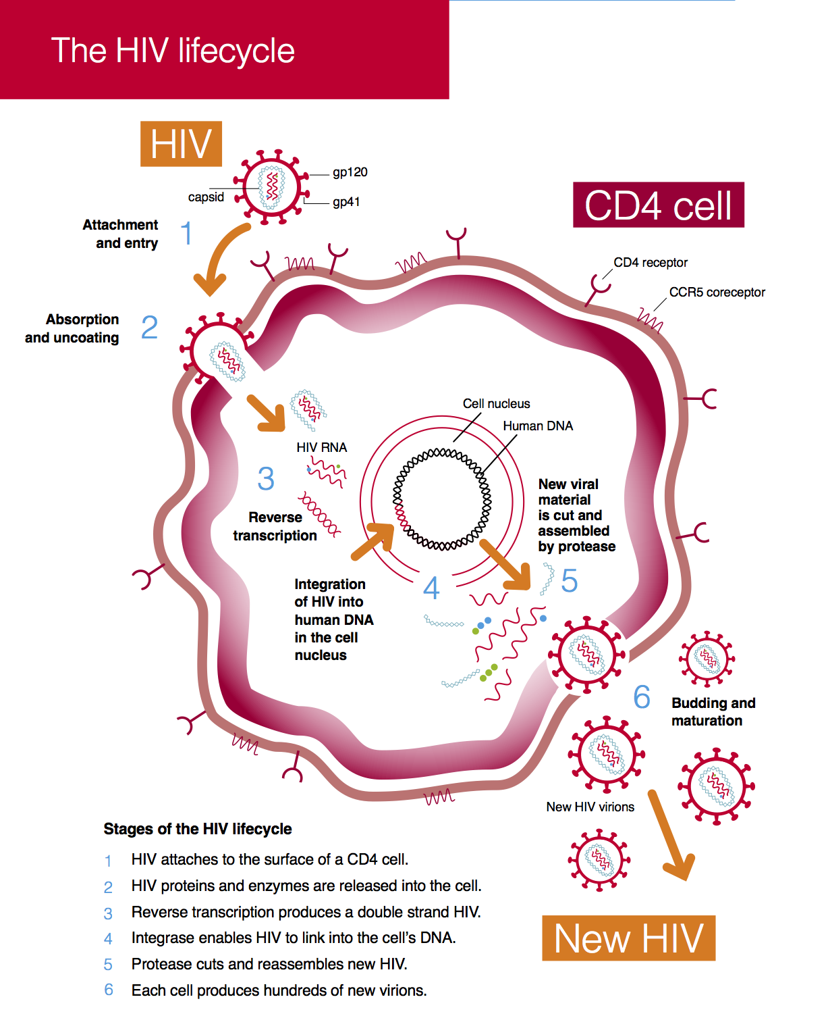
The process is believed to be initiated by binding of viral surface protein (gp120) to host cell CD4, resulting in conformational changes that enable interaction with a co-receptor (CCR5 or CXCR4);
This exposes a second viral protein (gp41), which mediates host/virus membrane fusion. It is generally only following interaction with the co-receptor that infection by primary HIV-1 strains can take place.
Viral strains that are transmitted and establish new infections tend to require the presence of CCR5 (these are termed R5-tropic strains).
Viral entry via CXCR4 (X4-tropic strains) is typically seen in later stages of disease progression and has been associated with rapid CD4 T-lymphocyte decline.
https://i-base.info/guides/art-in-pictures/the-hiv-lifecycle

Slide 3
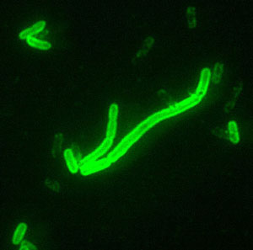
CCR5 is selected as the potential drug target
Approximately 1% of north European Caucasiansi carry a homozygous 32 base-pair deletion in the gene encoding CCR5 (CCR5-Δ32), resulting in the lack of functional CCR5.
Implies CCR5 is functionally redundant
For people with this mutation, CCR5 (CCR5-Δ32) blocked the entry of HIV, providing immunity to AIDS for homozygous carriers and greatly slowing progress of the disease in heterozygous carriers.
Block CCR5 stop the virus
Some researchers have proposed that the plague epidemics that repeatedly swept Europe during the Middle Ages were responsible for the mutation.
Yersinia pestis
鼠疫杆菌
https://creation.com/ccr5delta32-a-very-beneficial-mutation

Slide 4
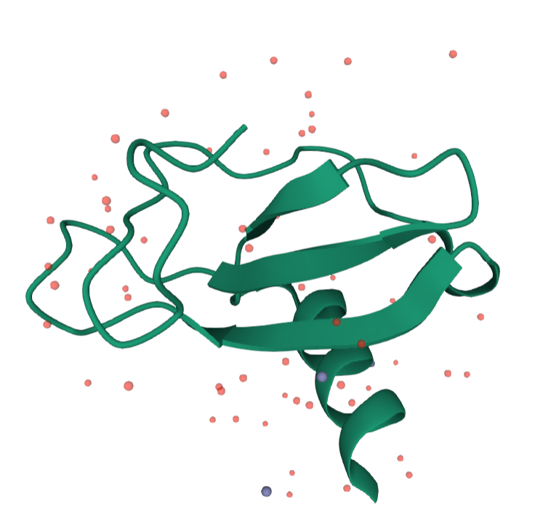
Conversion of endogenous peptidic leads into drugs is challenging
We do not know the binding pattern of the peptide with CCR5
We do not know the structure of peptide when binding with CCR5
We need to use small molecule to mimic the peptide’s complex interaction with CCR5 while we also need to improve other properties like metabolic stability
These complex interaction between peptide and protein may not be possible to replicate with a small molecule at all
MIP-1-beta
PDB code: 3TN2
https://www.rcsb.org/3d-view/3TN2/1

Slide 5
Questions
Why don’t we use the peptide as drug directly?
Do you have any idea to solve the peptide conversion problem?
Do you know any successful endogenous peptide-based drug design cases?

Slide 6
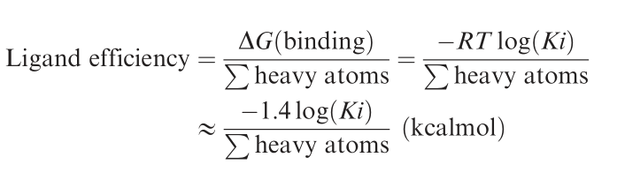
High throughput screening gives two lead compounds
1
mw=411
clogP=4.6
IC50=0.34μM
LE=0.29
2
mw=420
clogP=6.0
IC50=1.1μM
LE=0.21
The most potent hits from HTS are often the largest and most lipophilic compounds. However, these frequently tend to be the least tractable hits for conversion into drugs. Consequently, ligand efficiencies were calculated for hits from the CCR5 screen to re-bias hits towards those showing the most efficient binding for their size.

Slide 7
Questions
What is ligand efficiency? Why do we need this concept?

Slide 8
Before Developing SAR
Compound 1 faces several problems
Strong activity was observed against the cardiac hERG potassium ion channel (IC50<316 nM)
Strong inhibition of the P450 cytochrome 2D6 isoform (IC50=40 nM)
Reduce lipophilicity
https://www.drugtimes.cn/2019/01/07/a2680ad6d1/
https://www.mayoclinic.org/tests-procedures/cyp450-test/about/pac-20393711

Slide 9
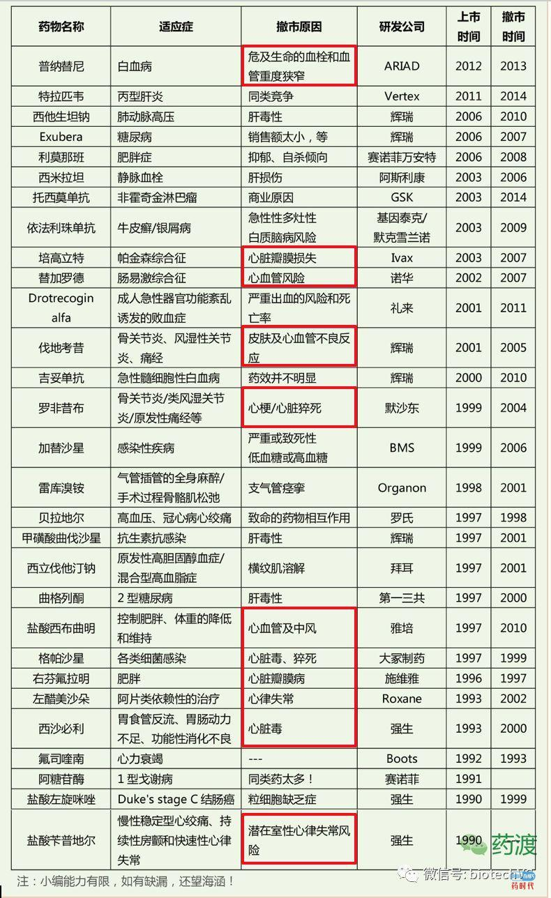
https://www.drugtimes.cn/2019/01/07/a2680ad6d1/

Slide 10
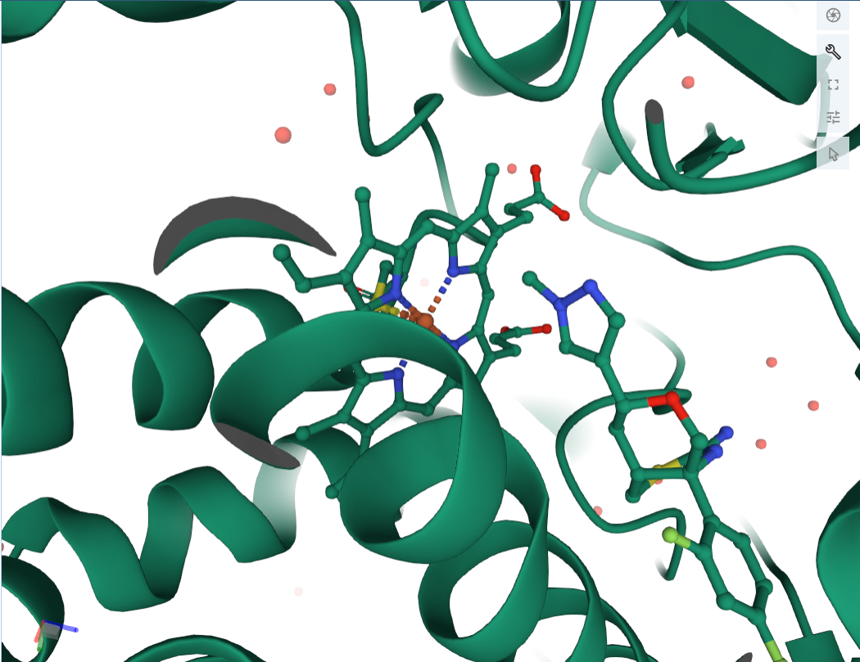
Human Cytochrome P450 2D6 BACE1 Inhibitor 5 Complex
4XRY
https://www.rcsb.org/3d-view/4XRY?preset=ligandInteraction&sele=HEM

Slide 11
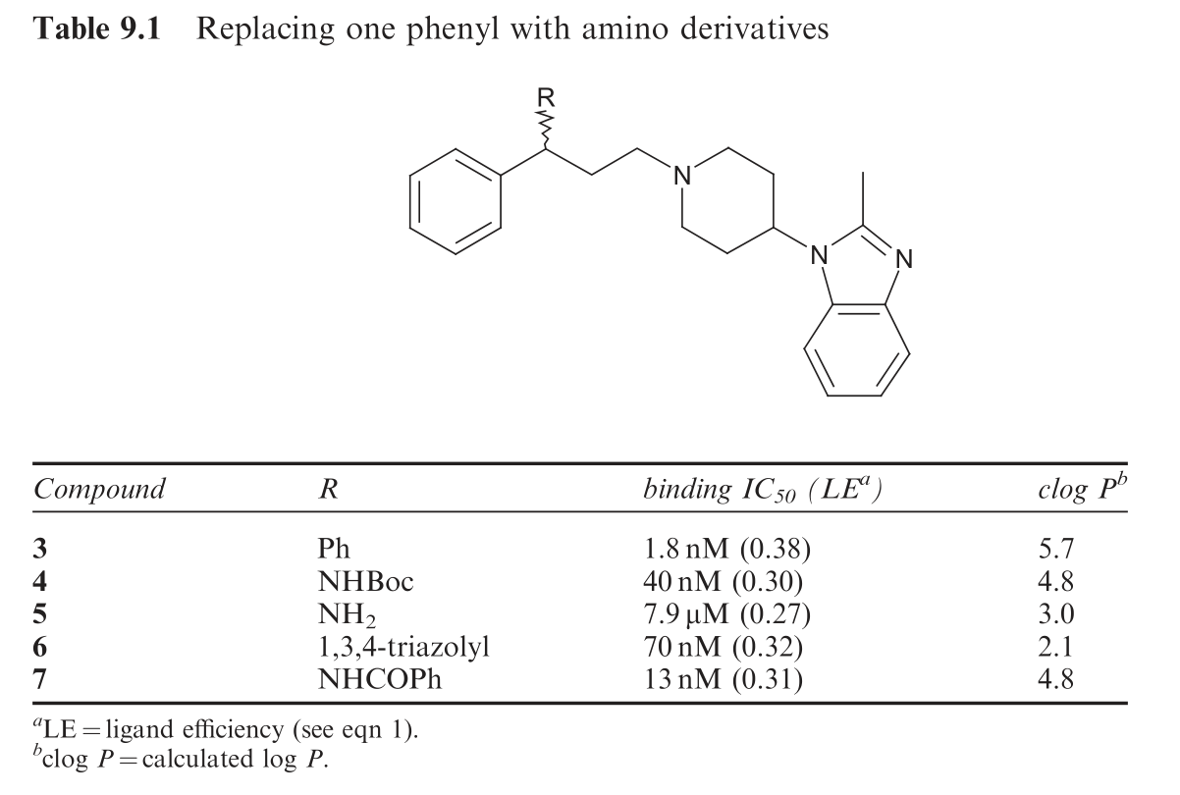
Change N to C, reduce CYP2D6 IC50 to 710 nM, see 3

Slide 12
Reduction in lipophilicity remained critical for this series and the diphenyl methylene moiety was targeted.
It was proposed to remove one of the phenyl rings and replace it with either a polar heterocycle (should aromaticity be required) or just a small group (should a conformational constraint be sufficient)

Slide 13
Question
Why lipophilicity is so important?
Do you have any idea about get better lipophilicity result with or without experiment?

Slide 14
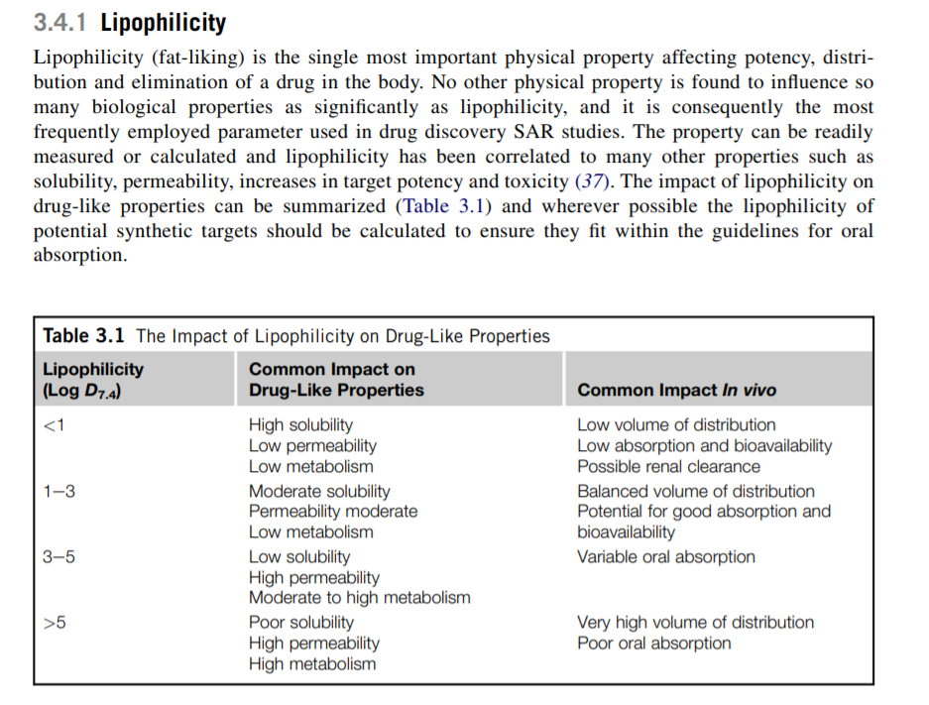
Sorry, this is logD not logP
https://www.sciencedirect.com/topics/chemistry/lipophilicity

Slide 15
Heterocycles both reduced lipophilicity and appeared to be tolerated, they were synthetically less accessible than simple amides and carbamates.
Even more encouragingly, 7 demonstrated antiviral activity (AV IC90 = 0.4 mM) and consequently a wider range of less lipophilic amides were prepared in a parallel manner.

Slide 16
8
Binding IC50 = 4 nM
AV IC90 = 440 nM
CYP2D6 Activity (IC50 = 5 μM)
Not what we want

Slide 17
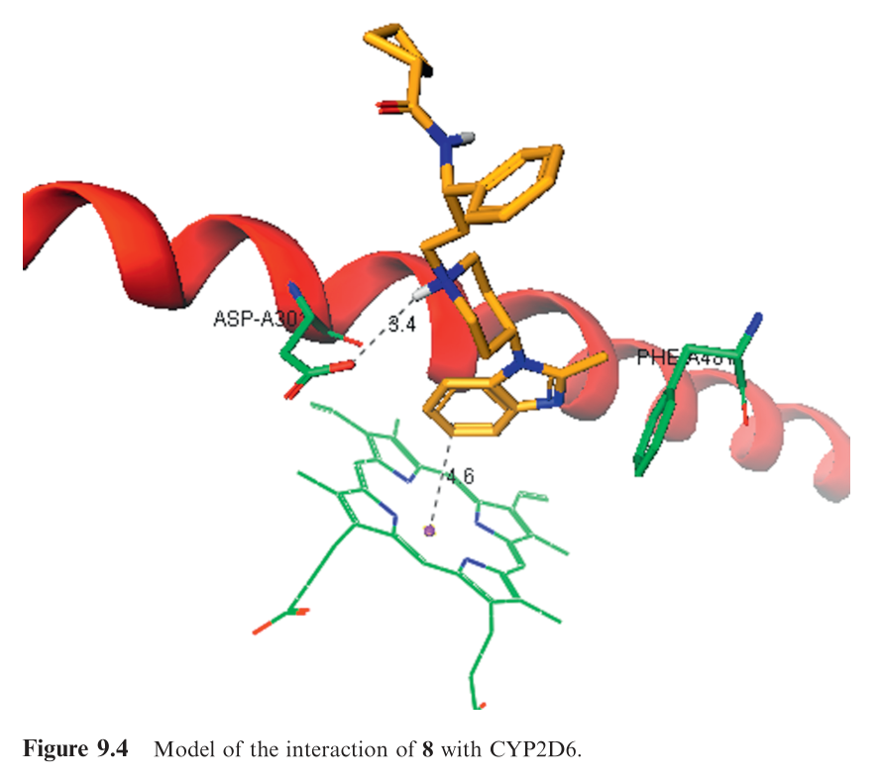
Binding pattern was analyzed
This central N atom can interact with CYP2D6. One way to solve this problem is to add more steric effect.

Slide 18
Question
Any new ideas about how to analysis binding pattern?

Slide 19
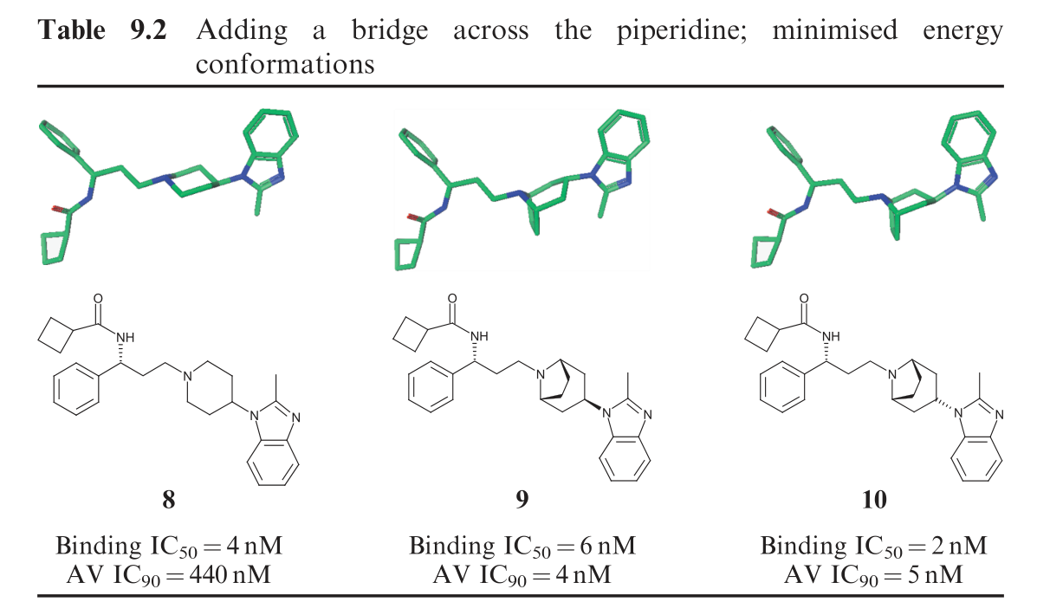
The addition of this bridge (from 8 to 9 and 10) was pivotal in the development of this series. In a single step, it completely ablated activity against CYP2D6 with negligible impact on CCR5 binding affinity (no activity against CYP2D6 at 2.3 mM).

Slide 20
Question
Why is adding a bridge so effective?

Slide 21
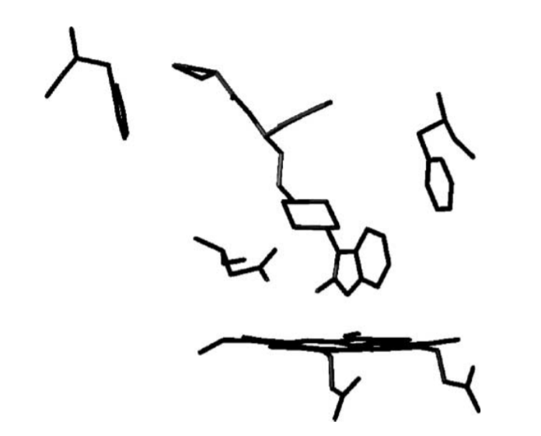
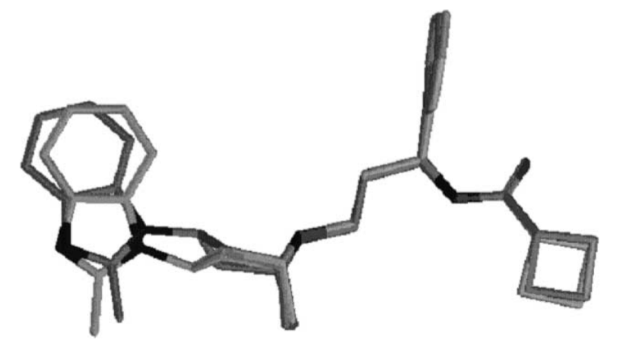
before
after
N atom

Slide 22
For hERG ion channel:
9, 99% inhibition at 1 mM;
10, 80% inhibition at 300 nM)

Slide 23
We solved the problem with CYP2D6, but now we are having problem with hERG, what should we do first?

Slide 24
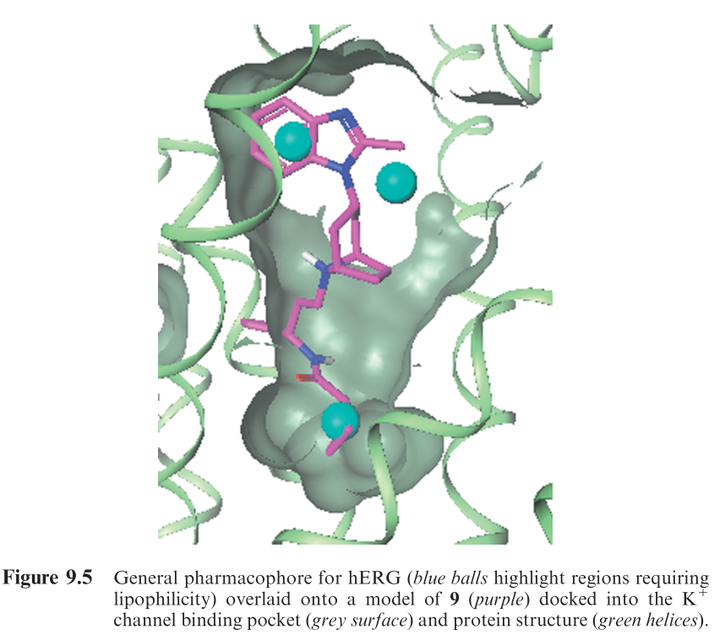
Again analysis the binding pattern
The SAR analysis suggest that Introduce polarity to these two place could reduce hERG activity
Here is more synthetically accessible

Slide 25
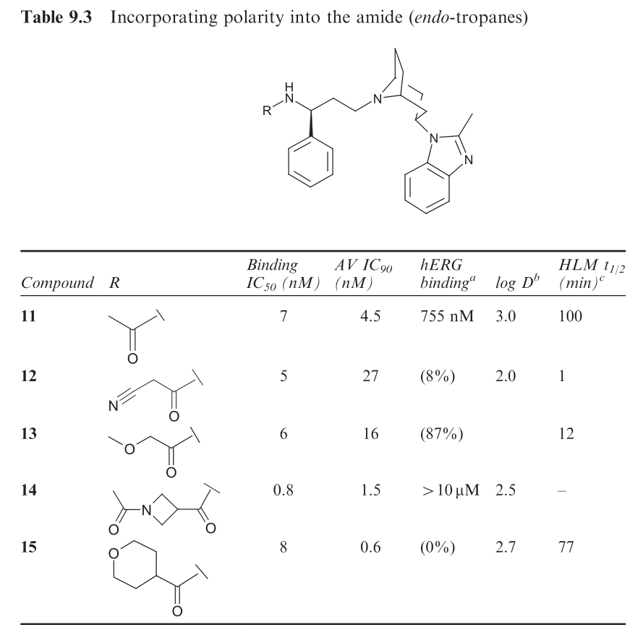
Try to introduce polarity into the amide first
Looks promising

Slide 26
15
A slow off-rate from CCR5 (t1/2 = 3.5 h, as determined by radiolabelled washout studies)
Slow receptor disassociation could give a pharmacodynamic advantage in vivo by retaining antiviral activity after free plasma levels had dropped below efficacious levels
Binding NOT equally to antiviral ability

Slide 27
Question
Could you find other examples that binding and antiviral ability is discrepant?

Slide 28
BUT
When 15 was studied in vivo, the oral bioavailability in the dog was low (<10%), which was ascribed to high first-pass clearance.
Reducing the lipophilicity seemed to offer the best chance of improving metabolic stability.
Given the molecular weight, a strategy of removing lipophilicity was undertaken rather than adding polarity. Such an approach was supported by Lipiniski’s analysis of the probability of achieving good oral bioavailability with compounds with a molecular weight under 500.
The benzimidazole fragment became a focus for this phase of the optimization.
https://en.wikipedia.org/wiki/First_pass_effect

Slide 29
Lipinski's Rule of Five states that, in general, an orally active drug has:
Not more than 5 hydrogen bond donors (nitrogen or oxygen atoms with one or more hydrogen atoms)
Not more than 10 hydrogen bond acceptors (nitrogen or oxygen atoms)
A molecular weight under 500 g/mol
A partition coefficient log P less than 5
http://scfbio-iitd.res.in/software/drugdesign/lipinski.jsp

Slide 30
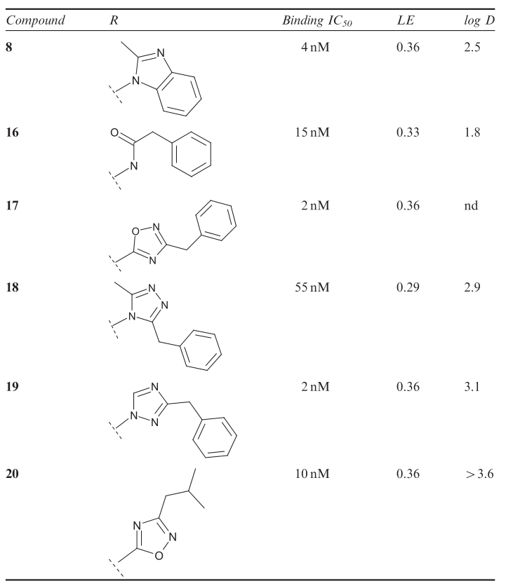
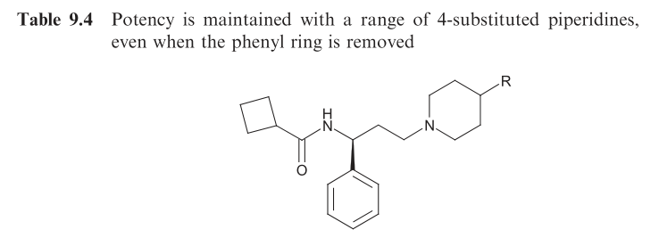

Slide 31
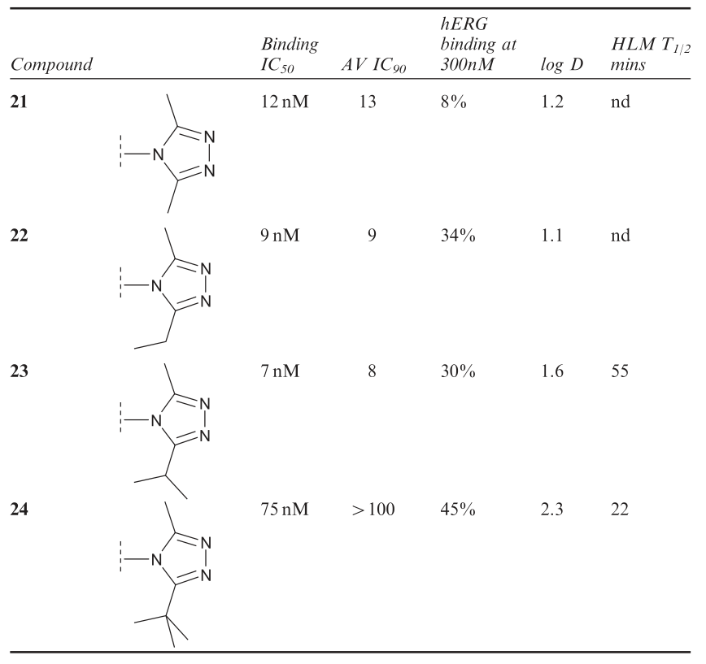
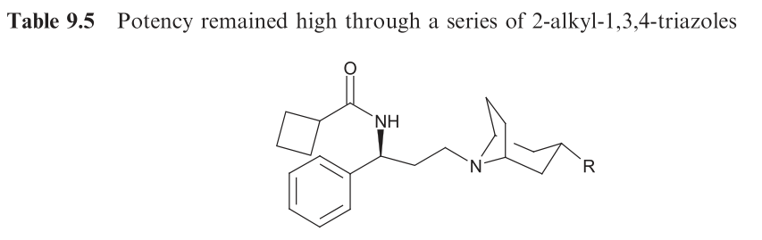
Dangerous, how to solve this problem?

Slide 32
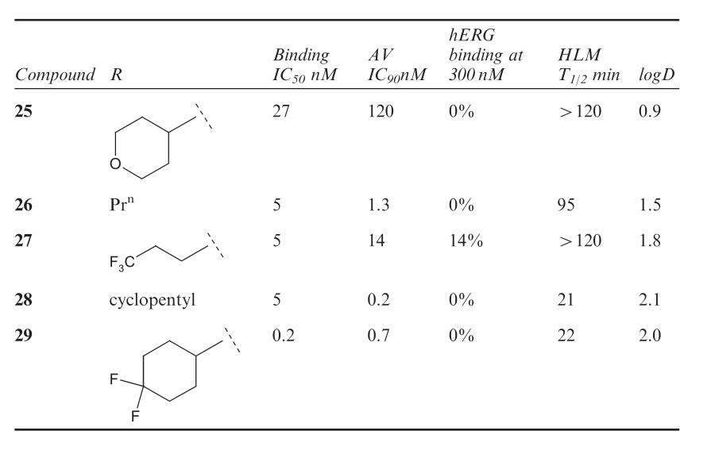
51
52
https://www.sciencedirect.com/science/article/pii/S0079646805430076

Slide 33
51
52
Compound 29 passed into development at the end of 2000. This was the culmination of about 2.5 years work and almost 1000 analogues.

Slide 34
What has been done?
Why?
Maraviroc

Slide 35
Question
Any idea about how to accelerate this procedure?

Slide 36
Main References
[1] Wood, A. , and D. Armour . "The discovery of the CCR5 receptor antagonist, UK-427,857, a new agent for the treatment of HIV infection and AIDS." Progress in Medicinal Chemistry 43.43(2005):239-271.
[2] Barber, C. , and D. Pryde . "Chapter 9:From HTS to Market: the Discovery and Development of Maraviroc, a CCR5 Antagonist for the Treatment of HIV." Plos One 6.9(2010):e25581-e25581.

Slide 37
AI-aided drug

Slide 38
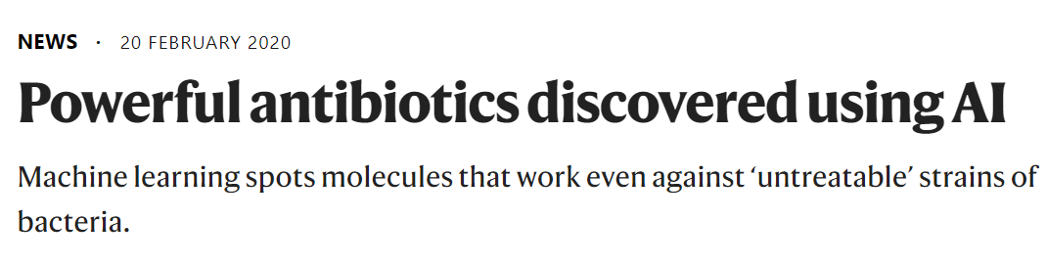
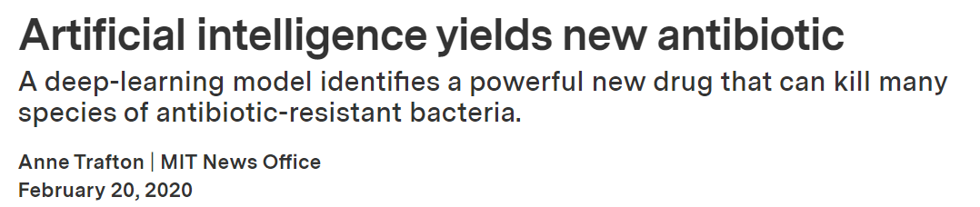
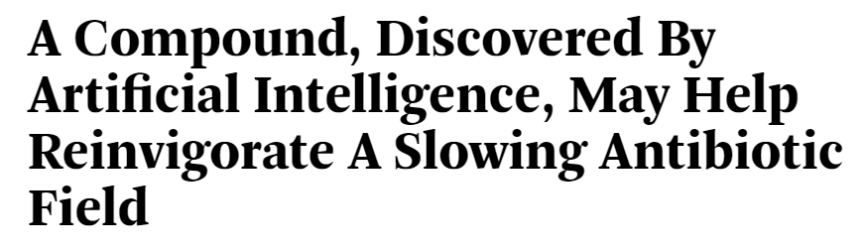
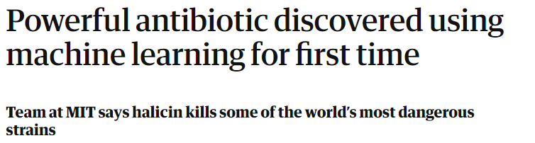
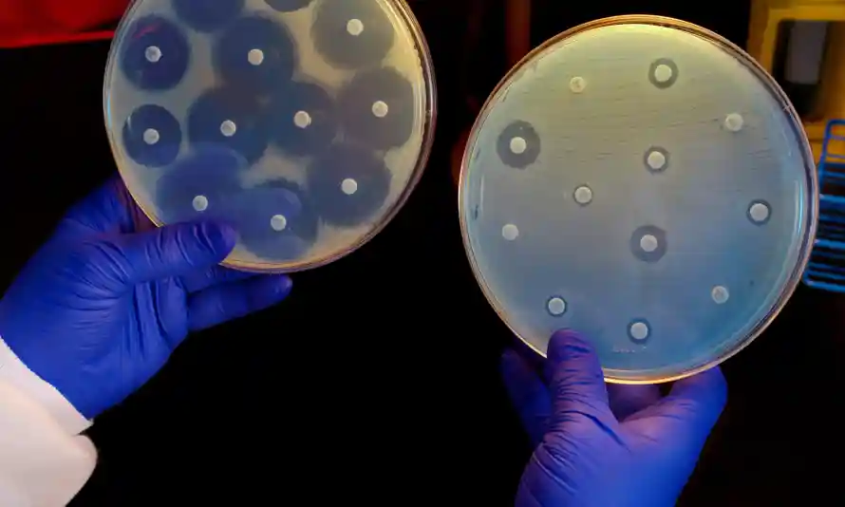
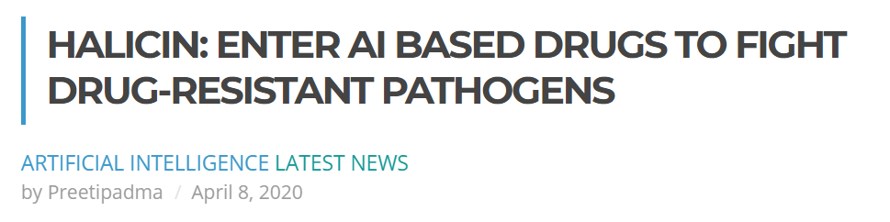

Slide 39
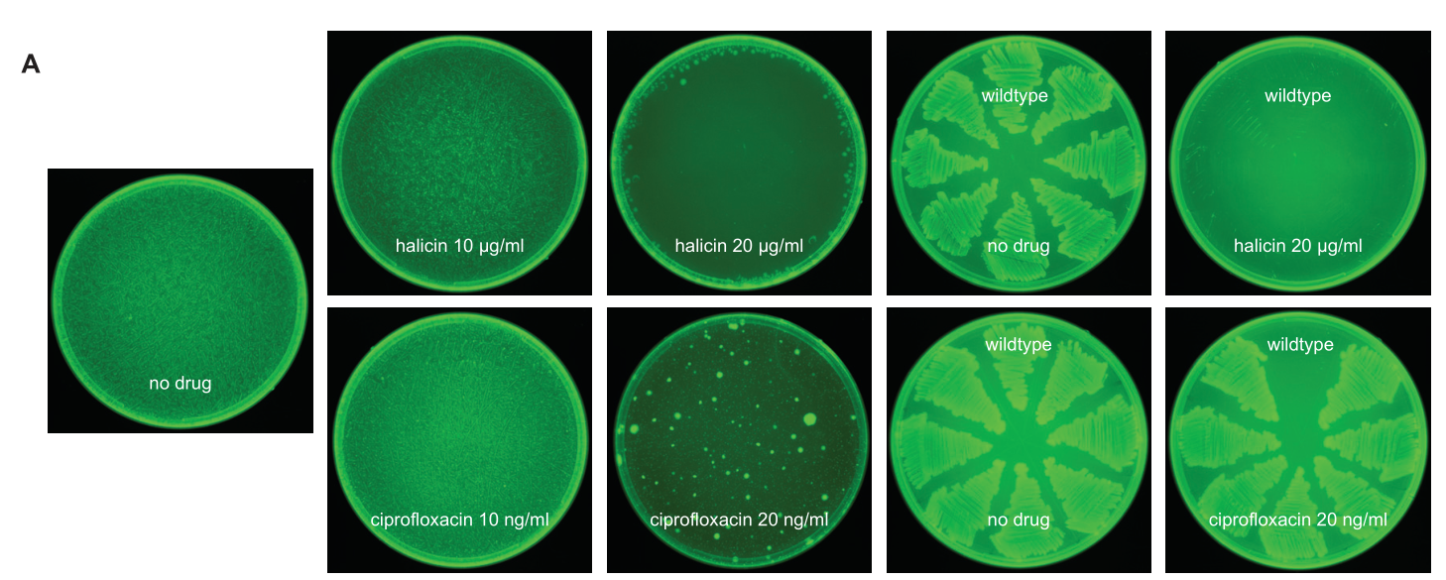
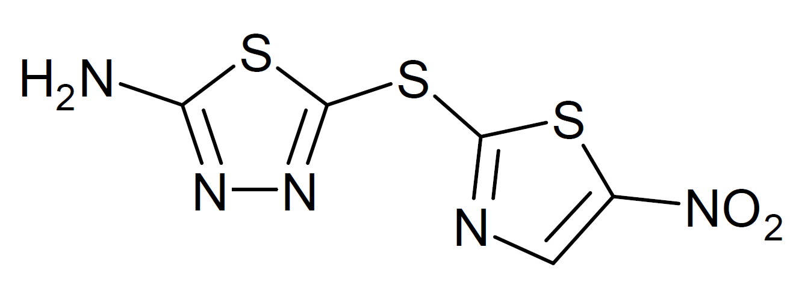
HALICIN

Slide 40
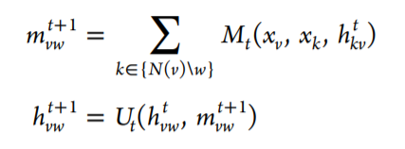
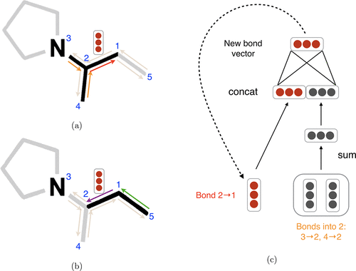
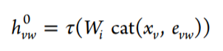
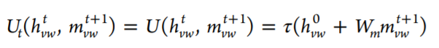
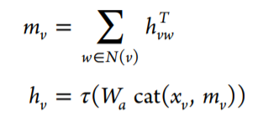
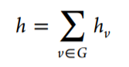
Model
update
with
then
finally
Yang, K. , et al. "Analyzing Learned Molecular Representations for Property Prediction." Journal of Chemical Information and Modeling 59.8(2019).

Slide 41
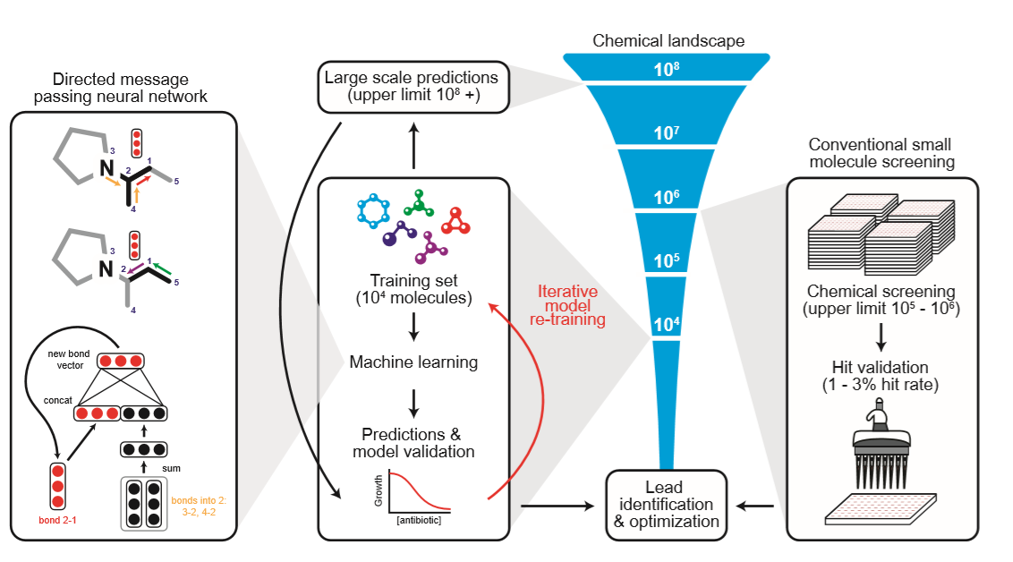
Training dataset of 2,335 molecules
FDA-approved drug library: 1,760 molecules
~800 natural products
comes out
Identify potential antibacterial molecules from the Drug Repurposing Hub:
6,111 molecules at various stages of investigation for human diseases.

Slide 42
Questions
Why they use molecules from drug repurposing hub?
What can you learn from the discovery of HALICIN?
What’s your opinion about AI-aided drug discovery? Is it promising?

Slide 43
[1] Yang, K. , et al. "Analyzing Learned Molecular Representations for Property Prediction." Journal of Chemical Information and Modeling 59.8(2019).
[2] Stokes, J. M. , et al. "A Deep Learning Approach to Antibiotic Discovery." Cell 180.4(2020):688-702.e13.
https://github.com/chemprop/chemprop

